Slide 1



littleBeasts
the falllen star of arkham

Slide 2
Our Vision
A tile based pixelart 2D-game
Universe inspired by H.P. Lovecraft
fighting system is one of a kind and completely engineered from the ground up
Catch or tame
Level up your friendship-lvl
Captivating story
Unique Easter Eggs
unique and unforgettable experience

Slide 3
The World
5 distinct Regions to Explore
Arkham City
Starting Area, dark and mysterious city
Ivory Forest
Endgame, dark and mysterious forest
Dunwich
Dark and mysterious Burrito
Miscatonic Mountains
Dark and mysterious Mountains
Insmouth
Dark and mysterious Swamplands

Slide 4
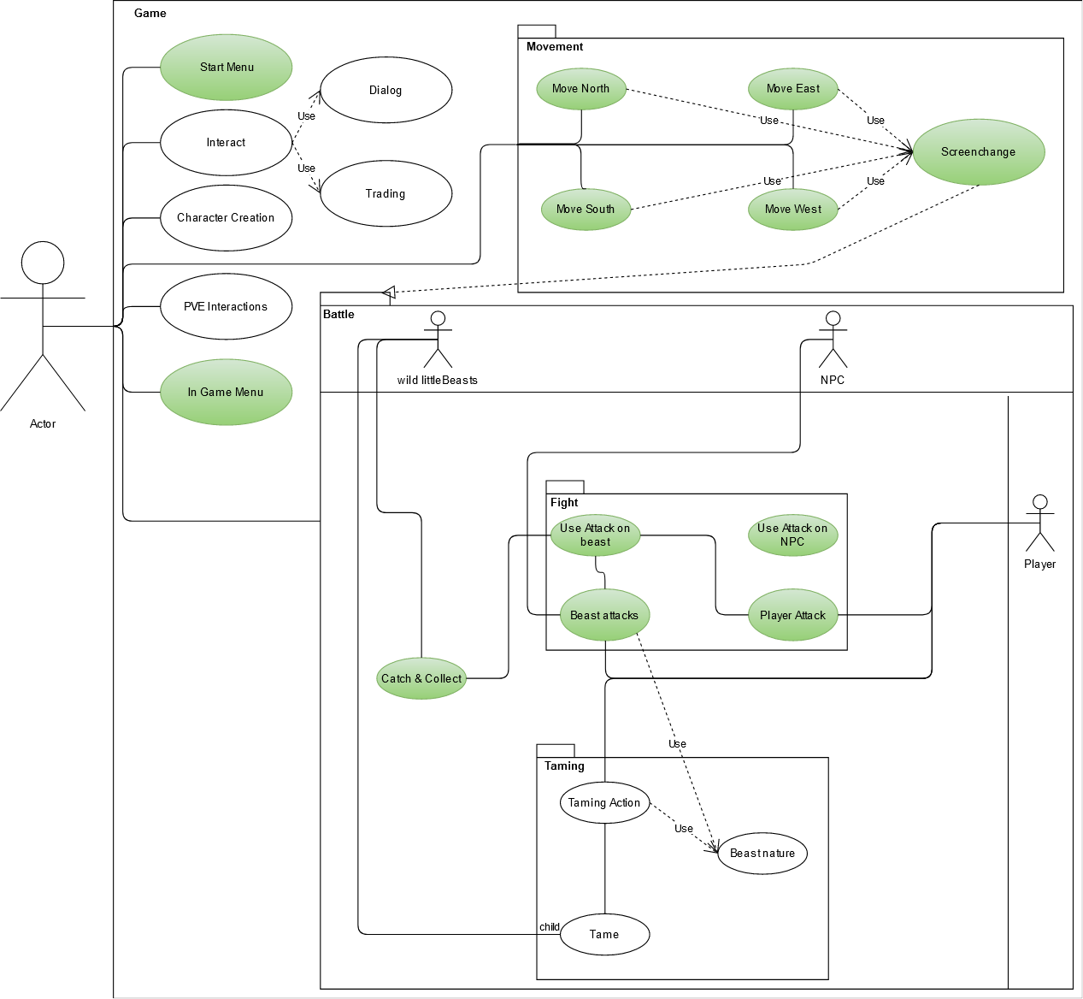
The Scope
Legend:
Green: Current Scope, already implemented
White: tbd.

Slide 5
LIVE DEMO

Slide 6
Technologies - LitiEngine
2d Tilebased Game library
Developed by: Gurkenlabs
Tools:
Utiliti: Ressource Management ( Maps, Sprites…)
Tiled: Map Editor
Assets: itch.io (Character Designs and Beasts will be exchanged by unique designs)
Benefits:
Already Implements Basic Gamelogic (Movement, Map loading, Effects, UI, Assetloading, Physics…)
Comes with a Variety of tools
Uses Plain Java

Slide 7
High-Level Architecture
Liti-Classes
CalculationEngine
-
Includes basic data models
Generates new entities
Generates stats
Handles Battle
AI for PVE
Calculates damage, catching, etc..
Future proof -> Multiplayer
Easy to maintain -> modular
Uses OO-Inheritance and OOP

Slide 8
Live Test Session

Slide 9
projectmanagement

Slide 10
Roles
Lawand: Implementer, Integrator, Test Manager, Test Designer, Designer
Andreas: Implementer, Integrator, Test Analyst, Designer, Deployment Manager
Daniel: Business Process Analyst, Lead Story Architect, Change Control Manager, Process Engineer
Leon: Project Manager, Change Control Manager, Software Architect

Slide 11
Youtrack / Scrum

Slide 12
Workflow
IntelliJ
Project Structure
Github
Code Reviews
Riskmanagement: -> Code Reviews, Tests, Researchphases
Refactoring

